Slide 1

Department of Computer Engineering Academic Year (ODD 2024-25) 22CEE58 - Mini Project using JAVA
PENSION FUND MANAGEMENT SYSTEM
Team Members DIKSHYAA SATAPATHY- 1NH22CE010
MADHU HOSAKOTI- 1NH22CE024 SWATI SHASTRI- 1NH22CE057
Reviewer
Mr. RAHUL. B
ASSISTANT PROFESSOR
Dept. of CE,NHCE

Slide 2
Contents
Objectives
Abstract
Problem Definition
Requirement Specification
Design
Methodology
Implementation
Result
Conclusion

Slide 3
Objectives
The aim is to create a contemporary pension fund management system that tackles inadequacies, amplifies transparency, maximizes investment approaches, minimizes hazards, guarantees adherence to regulations, and reinforces security protocols. Through the accomplishment of these goals, the system hopes to protect retirees' financial security, optimize administrative procedures, and build stakeholder confidence in the integrity of the pension system, all of which will contribute to the development of a strong and effective framework for pension fund management.

Slide 4
Abstract
The Pension Fund Management System (PFMS) is a software solution designed to automate and manage pension accounts, contributions, and withdrawals. Built with Java for backend logic and SQL for data storage, it ensures modularity, scalability, and secure data management. Core features include employee registration, pension contribution tracking, retirement benefit projections, and withdrawal processing. It calculates pension benefits based on parameters like age, contributions, and tenure. The system facilitates accurate and efficient pension management for employees from registration to retirement.

Slide 5
Problem Definition
The management of pension funds is currently beset by inefficiencies, a lack of transparency, and susceptibility to risks like fraud and noncompliance with regulations. The aforementioned obstacles, when combined with changing demographics and uncertain economic conditions, highlight the pressing necessity for an updated pension fund administration system. A system of this kind should simplify administrative procedures, improve openness, maximize investment plans, reduce risks, guarantee legal compliance, and strengthen security protocols. The goal is to develop a robust and effective pension fund management system that protects retirees' financial security and builds stakeholder confidence in the integrity of the pension system by tackling these issues head-on.

Slide 6
Requirement Specification
HARDWARE AND SOFTWARE REQUIREMENTS
HARDWARE: An Intel Pentium processor to guarantee seamless operation.
8 GB of RAM at minimum; however, for better multitasking, more RAM is advised.
A minimum 128GB storage space to hold the data and related files for the system.
SOFTWARE:
Java Spring Boot is the backend framework used to develop the backend
application.
Front-end architectures: The JavaScript library React.js, which is used to create
the user interface.
CSS, which styles the elements of the front end.
MYSQLSQL is the principal Relational Database Management System (RDBMS) utilized for data storage.
Tool Development: An Integrated Development Environment (IDE) such as Eclipse
or IntelliJ IDEA for Java development.

Slide 7
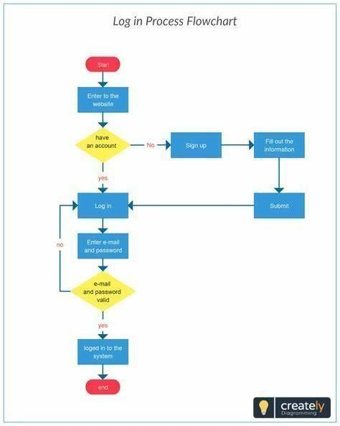
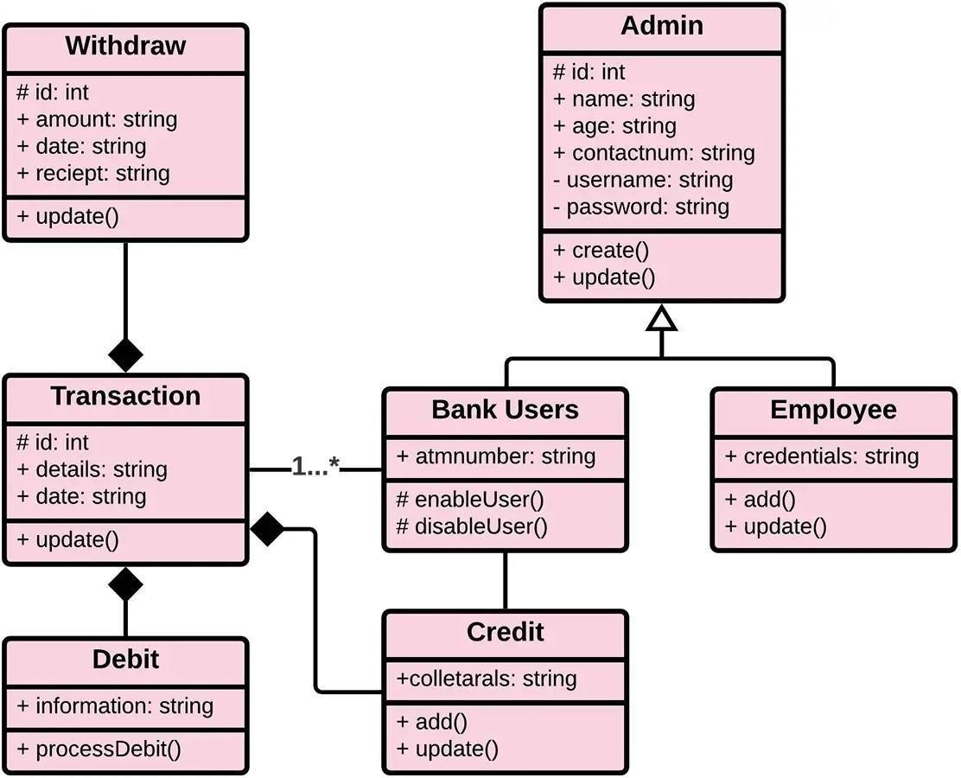
Design
1. DATABASE STRUCTURES
2. FLOW CHART

Slide 8
Methodology
Requirement Analysis
System Design
Technology Selection
Development
Testing & Debugging
Deployment & Maintenance
User Training & Documentation

Slide 9
Implementation
The implementation of the Pension Fund Management System in Java involves creating classes for employee registration, pension calculation, and transaction management. Using Java's object-oriented principles, employee profiles, contributions, and retirement benefits are stored in classes with relevant attributes. Methods for contribution tracking and benefit calculation automate processes, ensuring accurate projections.
SQL is integrated for secure data storage and retrieval, with JDBC for database interaction. Security features like encryption and user authentication are implemented for data protection.
A user- friendly interface is built using JavaFX or Swing for easy navigation. Blockchain and AI components can be incorporated in future iterations for enhanced scalability and automation.

Slide 10
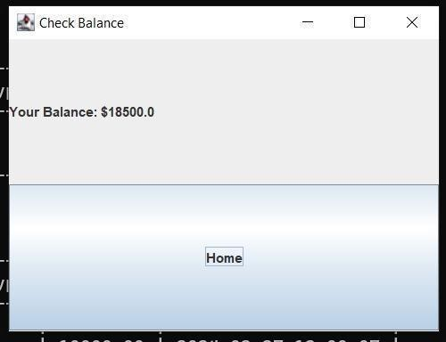
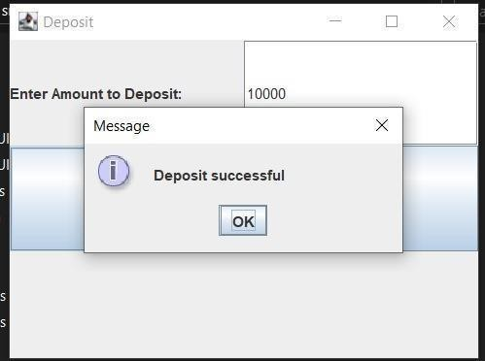
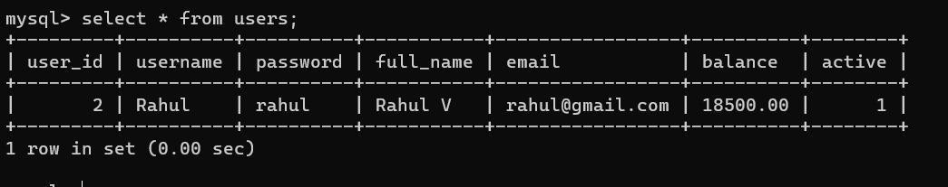
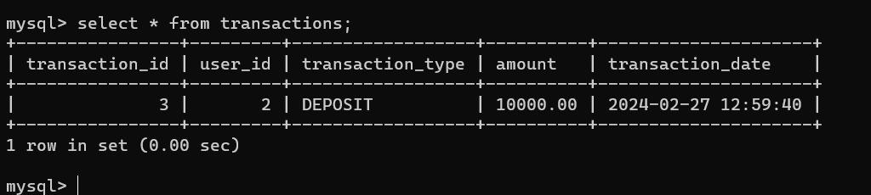
Result

Slide 11
Conclusion
The creation of the Pension Fund Management System marks a significant advancement in modernizing pension fund operations. It addresses key requirements such as accurate documentation, precise calculations, and a user- friendly interface. With robust security measures and automation, the system reduces errors and enhances efficiency in fund administration. By leveraging technologies like blockchain and AI, the system is scalable and adaptable to future needs. Its intuitive design empowers administrators, and with ongoing support, it aims to improve the financial stability and retirement well-being of millions globally.

Slide 12
THANKYOU!

